Slide 1
How to use these templates
Template 1:
Share a personal ambition, or an ambition your have for the food industry. Big or small, it doesn’t matter – we want you to share them!
Suggested ideas: “Stepping out of my comfort zone by leaning into new networking opportunities” “Becoming a mentor and passing my knowledge on” “Helping my team to recognise their strengths and progress their careers” “Being a present parent whilst delivering for my team” “Advocating for women in my team”
Save the template as a PNG and create a post on your social media pages, tagging Meat Business Women and using the hashtag #AmbitionLooksLike
Template 2:
Save this as a PNG and and create a post on your social media pages, tagging Meat Business Women and using the hashtag #AmbitionLooksLike
Suggested post wording: I’m supporting @Meat Business Women’s campaign Fuelled by Ambition, which urges the food industry to take bold steps toward a more balanced, inclusive, and inspiring future, whilst celebrating the incredible ambitions of the people who work in our industry. #AmbitionLooksLike
Both templates are formatted for Linkedin, Instagram and X.

Slide 2
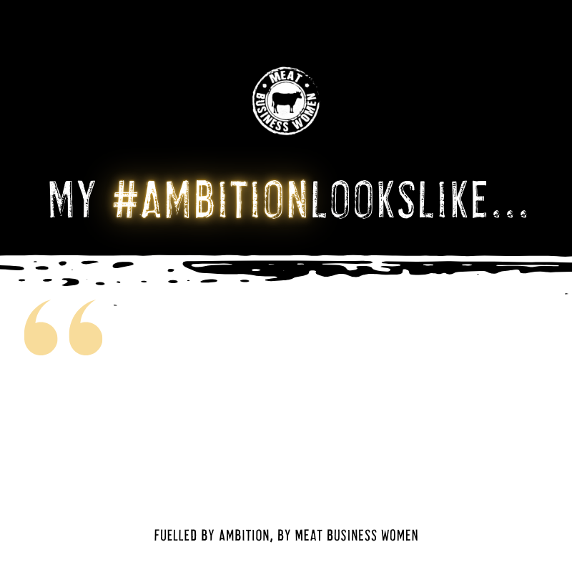
Type out your own ambition here.

Slide 3
